Slide 1

Exceptional Handling
JAVA & ANDROID

Slide 2
INTRODUCTION
Dictionary Meaning: Exception is an abnormal condition.
In java, exception is an event that disrupts the normal flow of the program.
It is an object which is thrown at runtime.
Suppose there is 10 statements in your program and there occurs an exception at statement 5, rest of the code will not be executed i.e. statement 6 to 10 will not run.
If we perform exception handling, rest of the statement will be executed. That is why we use exception handling in java.

Slide 3
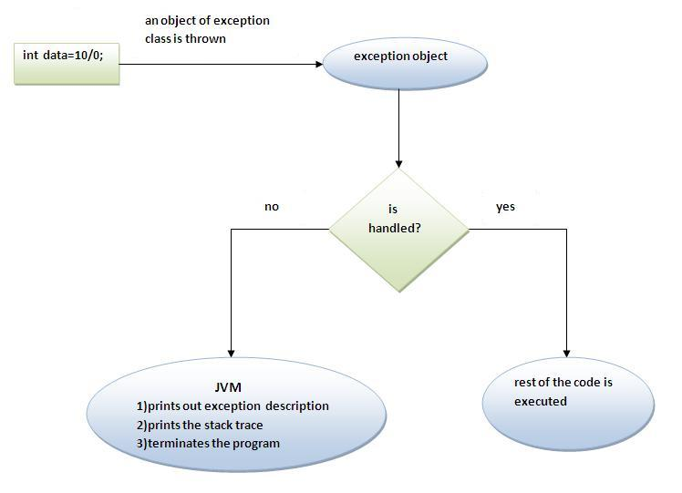

Slide 4


Slide 5
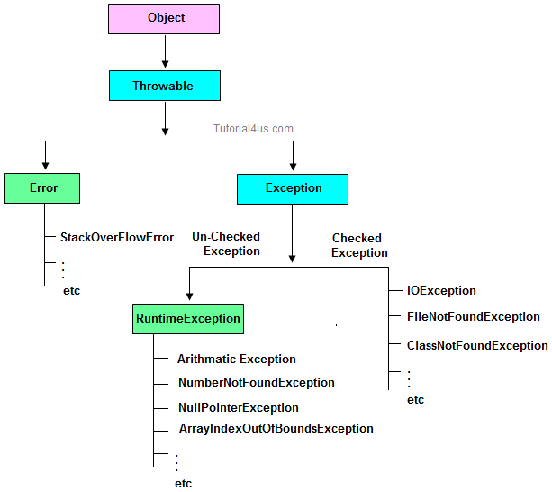

Slide 6
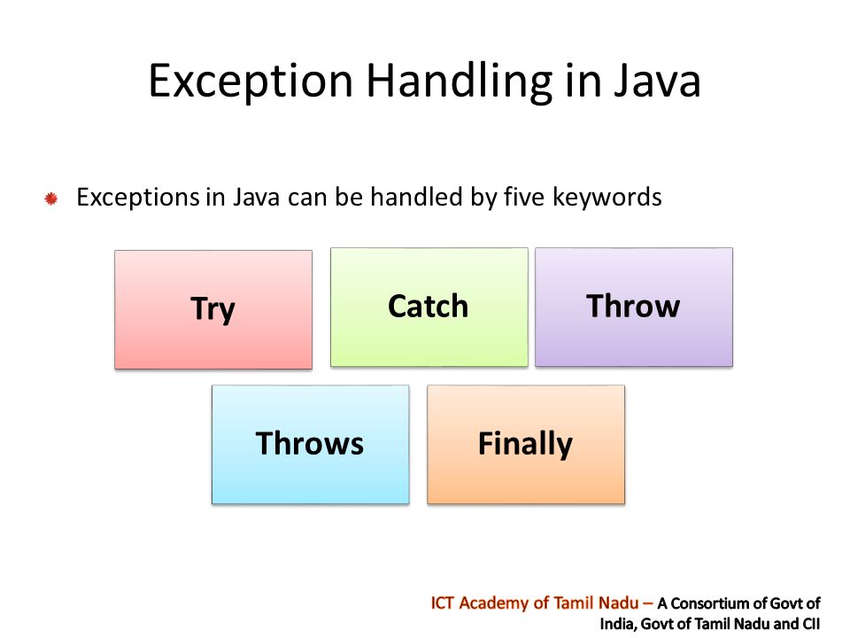

Slide 7
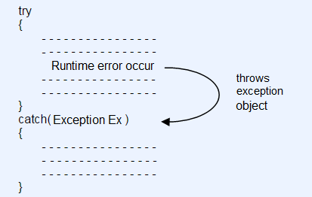

Slide 8
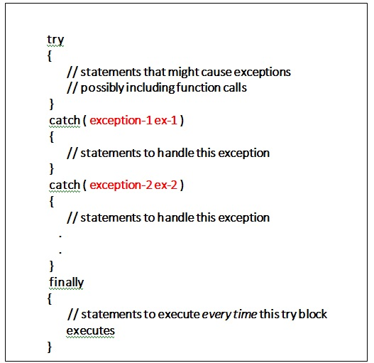

Slide 9
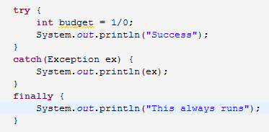

Slide 10
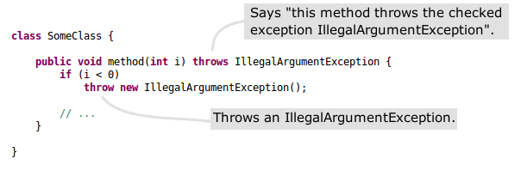

Slide 11
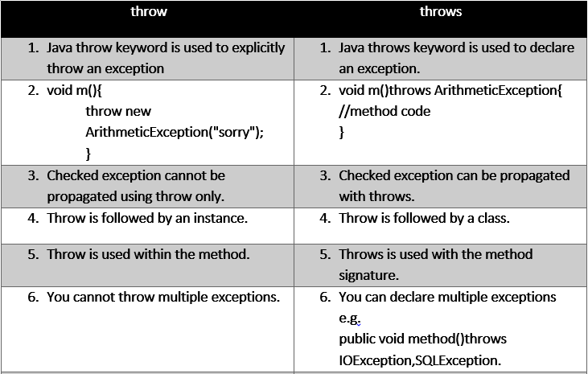

Slide 12
Common scenarios where exceptions may occur
If we divide any number by zero, there occurs an ArithmeticException.
int a=50/0;//ArithmeticException
If we have null value in any variable, performing any operation by the variable occurs an NullPointerException.
String s=null;
System.out.println(s.length());//NullPointerException
The wrong formatting of any value, may occur NumberFormatException. Suppose I have a string variable that have characters, converting this variable into digit will occur NumberFormatException.
String s="abc";
int i=Integer.parseInt(s);//NumberFormatException
If you are inserting any value in the wrong index, it would result ArrayIndexOutOfBoundsException.
int a[]=new int[5];
a[10]=50; //ArrayIndexOutOfBoundsException

